Slide 1
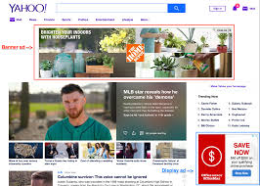
News Paper Advetisement
Management
Gajendra Negi
Pulak Sinha
Bhagyasri Manchella
Aparna Kacham
Rana Utkarsh Vikram
Soumya Jena

Slide 2
News Paper Advetisement
This app is made to Interact with news paper agency and customer who want to give ads.
The admin can oversee and manage all the accounts, as well as view customer ads request.
Customer can see and apply for advertisement acording to his requirement.
Admin can view and approve add request made by customer and same status show to customer.

Slide 3
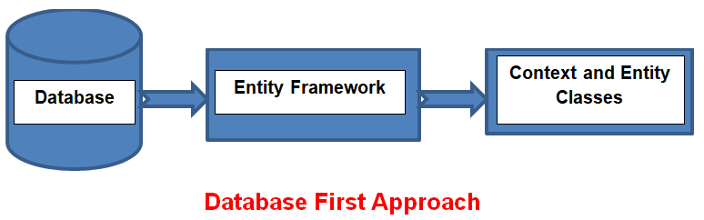
Architecture
Database
CRUD Operations using database first approach in MVC

Slide 4
Technology Requirements
DotNet MVC 5.0
Microsoft SQL Server Management Studio 18.6
Bootstrap 3
CSS
HTML
ADO DOTNET Entity Framework 6

Slide 5
Scope Of New Paper Advertisement App
Security
Ideas
Operations
Uses
Validations for respective inputs
Session Management
Easy to operate
Scalable
Secure
View All Users(Admin and customer)
Admin login
User login
User can give a Ads request
Admin can view user info and ads requested by user and approve request.
User can track ads status
Customer and News Paper agencies can communicate easily.
User can Request different type of ads in online.

Slide 6
Thanks

